Slide 1

CogMem
Defense focus
• What was built: a typed memory graph pipeline.
• What was proven: judge-based LongMemEval and LoCoMo results.
• What remains: temporal errors and habit-specific validation.
Cognitively-Grounded Long-Term Memory for Conversational Agents
Typed memory graph + multi-channel recall + SUM spreading activation
Chat
Graph
Evidence
Answer
10-15 minute storyline: problem -> HINDSIGHT -> method -> retain demo -> experiments -> proof
Student: Le Minh Triet

Slide 2
Problem: long conversations break short-context memory
MOTIVATION
A useful assistant must remember across many sessions, but the answer is rarely stored as one clean sentence.
Session 1
Session 8
Session 17
Session 31
Session 47
Preference
Location
Plan
Outcome
Conflict
likes quiet hotels
Seattle trip
workshop next month
tool fix worked
updated answer
Raw log
Vector-only memory
Evaluation metric
too long and noisy for every prompt
semantic match, but weak relation/time control
must be consistent and transparent

Slide 3
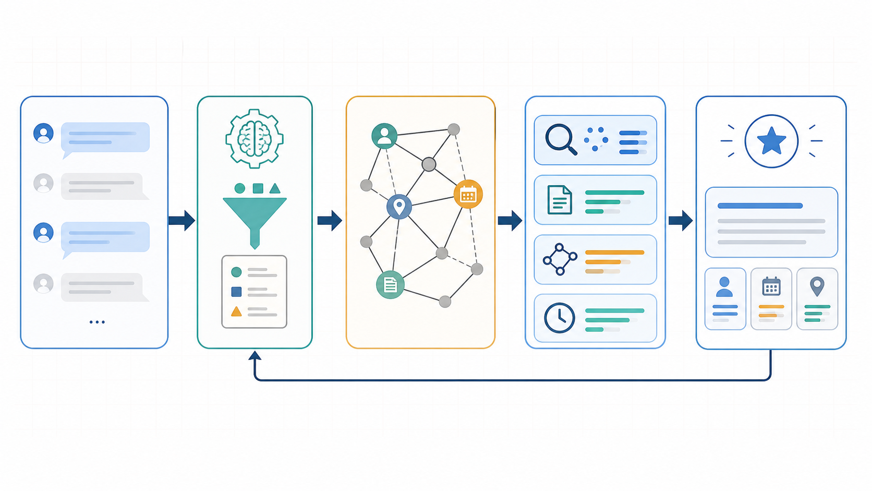
HINDSIGHT starts from observations before graph recall
BASELINE
1. Dialogue chunk
2. Observation extraction
3. Memory graph
4. Retrieval + answer
Why CogMem changes it: fewer node types are not enough; the retain path must be faster, more typed, and less node-heavy.

Slide 4
Retain walkthrough: raw dialogue becomes typed evidence
MEMORY REPRESENTATION
Fact extraction
Raw evidence
Typed memory node
Lossless evidence
• classify: experience / intention / action-effect / ...
• attach entities, dates, confidence and metadata
• embed for semantic retrieval
• create graph links for multi-hop recall
• keeps original wording and context
• prevents lossy summary errors
• supports evidence guard and judge scoring
• keeps dates/durations recoverable
Extracted fact
Raw snippet
User was in Seattle before traveling to Chicago.
"I stayed in Seattle before flying to Chicago."
Live walkthrough option: animate Raw log -> Fact -> Graph node as a timed build.
Animation: solid teal = intra-session links; dashed gold = inter-session links; red = recalled evidence path.

Slide 5

Six typed memory networks
MEMORY REPRESENTATION
World
Experience
stable facts
dated events
Opinion
Habit
preferences
routines
Intention
Action-effect
future plans
precondition -> action -> outcome
Honest scope
Intention and action-effect have targeted qualitative ablations. Habit is representationally useful, but still needs a routine diary workload.

Slide 6
Recall: four channels become one ranked evidence list
METHOD
Semantic
similar meaning
Top evidence
1. fact + snippet
BM25
Adaptive routing
lexical match
query type changes channel weights
2. dated memory
semantic | temporal | causal | prospective | preference | multi-hop
3. linked node
Graph
linked evidence
4. lexical hit
Temporal
time windows
Key claim: graph is important, but the final system is deliberately multi-channel.

Slide 7
Graph recall: SUM instead of MAX
METHOD
MAX baseline
SUM activation
Keeps the strongest single path
Accumulates many weak paths converging on the same answer node
A(v) = max(signal)
A(v) += total incoming signal
cycle guard 1: refractory
cycle guard 2: firing quota
cycle guard 3: saturation

Slide 8
Running example: before-travel question
EXAMPLE
Query: Which city was the user in before traveling to Chicago?
Memory A
Memory B
Answer
Seattle
Chicago
Seattle
earlier dated evidence
anchor travel evidence
before Chicago
1. Detect relation
2. Recall dated memories
3. Guard generation
before + travel + city
Seattle and Chicago evidence
answer from evidence only

Slide 9

Evaluation: judge PASS is the reported metric
EVALUATION
Reported scoring rules
• LLM-as-a-judge compares generated answer with gold.
• PASS/Total is the metric shown in this deck.
• Same judge policy across LongMemEval and LoCoMo.
• Internal run IDs and case IDs are hidden from reader-facing slides.
Question
CogMem answer
Judge verdict
Category totals

Slide 10
LongMemEval: multi-channel typed graph is strongest
RESULTS
31/35
30/35
35
Multi-channel + 6 types
HINDSIGHT baseline
Evaluation set
judge PASS = 88.6%
judge PASS = 85.7%
LongMemEval questions
Multi-channel + 6 types
88.6%
HINDSIGHT baseline
85.7%
Ablations
no habit stays 31/35; no action-effect/intention drops to 29/35
Takeaway: CogMem improves over HINDSIGHT when typed graph memory is fused with lexical, semantic, and temporal evidence.

Slide 11
Control experiment: SUM improves graph-only top-k priority
RESULTS
0.8052
0.7624
+0.0429
Graph-only SUM recall@5
Graph-only MAX recall@5
Absolute lift
mean session recall@5
mean session recall@5
SUM minus MAX at top-5
Rank budget view
Result interpretation
1
2
3
4
5
6
7
• Recall@10 is equal at 0.8481.
• SUM better in 2/35 questions.
• MAX better in 0/35 questions.
• Top-10 order changes in 12/35 questions.
Relevant evidence should land inside ranks 1-5.
Honest claim: SUM does not create new evidence; it moves convergent evidence earlier in the prompt budget.

Slide 12
LoCoMo: judge PASS crosses the 70% target
RESULTS
119/161
97/161
+22
Final evidence-guard configuration
Previous baseline
Recovered cases
judge PASS = 73.9%
judge PASS = 60.2%
additional PASS
multi-hop
91.7%
causal
90.9%
preference
88.2%
single-hop
71.6%
temporal
41.7%
Takeaway: the full system is useful on a harder long-dialogue benchmark, but temporal reasoning still needs focused work.

Slide 13
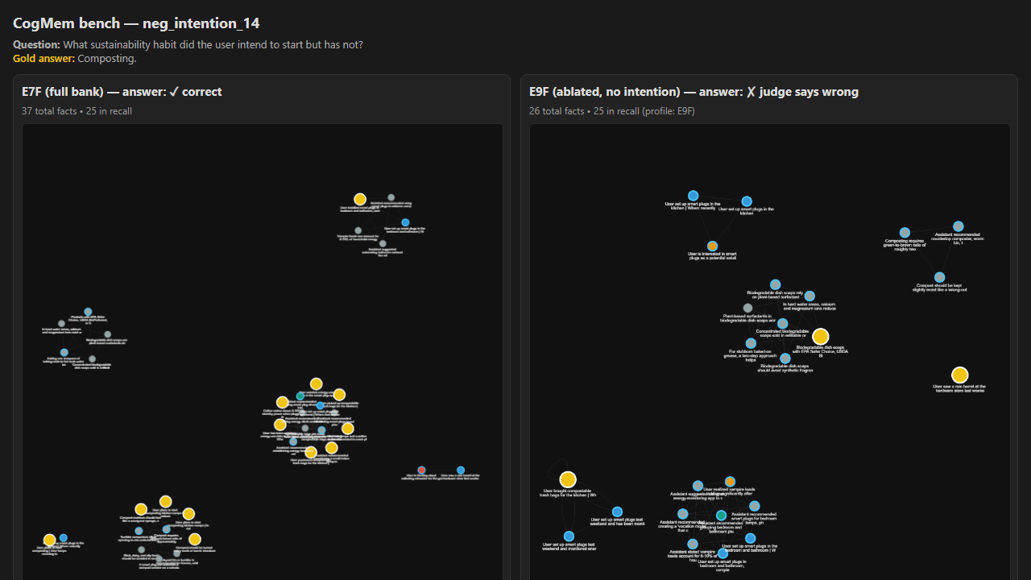
Qualitative proof: intention stores unfinished plans
TYPED MEMORY PROOF
Question: What sustainability habit did the user intend to start but has not?
Full bank: intention nodes preserve composting
Ablated: no intention nodes, decoy topic wins
Gold answer: Composting
Target question: What sustainability habit did the user intend to start but has not?
FULL BANK: gold representation exists
ABLATED BANK: gold representation removed
Full memory bank
Intention-ablated bank
37 facts | 4 intention nodes | cited [1,2,3,9,11]
26 facts | 0 intention nodes | only decoy evidence remains
37 facts, including 4 intention nodes
26 facts, 0 intention nodes
[intention] plans to start composting
[intention] kitchen scraps -> reduce waste
Missing component: no node says "plans to start composting"
plans composting
has not started
rain barrel
garden
no red plan nodes
[1] keeps meaning to compost, but has not gotten around to it yet
[experience] rain barrel / rainwater garden
Answer: Composting
[9][11] compostable trash bags = supporting evidence, not the answer itself
Wrong decoy: rainwater
trash bags
[5] started thinking about collecting rainwater; model answers the decoy topic
The gold plan remains physically present as intention-typed evidence.
The system still recalls evidence, but the missing type forces a topic swap.
Generated answer uses these cited nodes -> Composting
Discrimination claim: the gold answer exists only as typed intention facts in this case.
Interpretation: intention is not universally necessary, but it is necessary in sparse plan-not-done cases where no experience fact carries the same content.

Slide 14
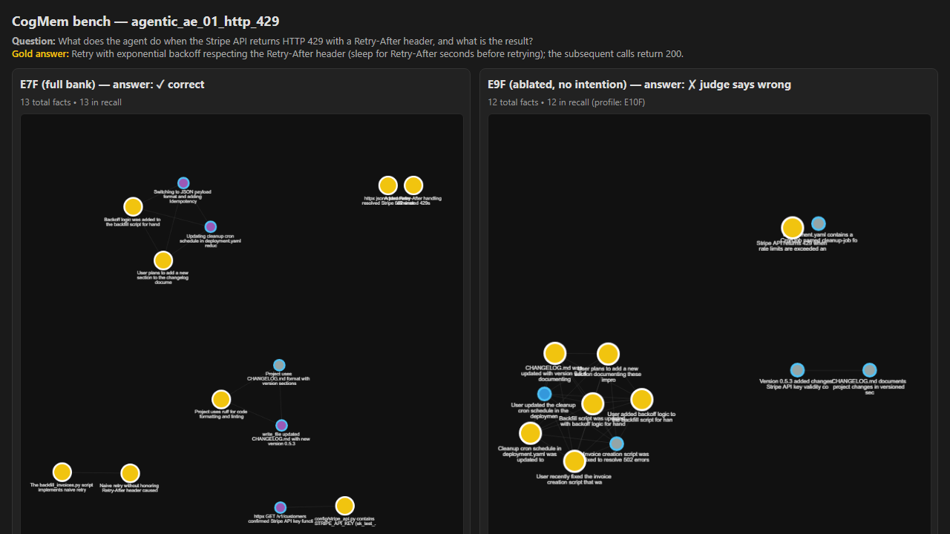
Qualitative proof: action-effect stores tool outcomes
TYPED MEMORY PROOF
Question: What does the agent do when Stripe returns HTTP 429 + Retry-After?
Full bank: action-effect stores cause -> action -> outcome
Ablated: exact causal triple disappears
Gold: backoff, sleep, then 200
Target question: When Stripe returns HTTP 429 with Retry-After, what does the agent do and what happens?
FULL BANK: causal triple is explicit
ABLATED BANK: causal bridge is missing
Full memory bank
Action-effect-ablated bank
13 facts | 7 action_effect nodes | cited [1,2,3,9]
12 facts | 0 action_effect nodes | recall is non-empty but incomplete
13 facts, including 7 action-effect nodes
12 facts, 0 action-effect nodes
precondition: HTTP 429 + Retry-After ignored
action: respect Retry-After + exponential backoff
outcome: subsequent calls return 200
[1] Stripe API returns 429 and includes Retry-After header
HTTP 429 Retry-After
sleep + retry
returns 200
429 has header
backoff added
specific sleep rule?
[7][8] Backoff logic was added to the script
[2] Added Retry-After handling eliminated 429s
[3] Naive retry without honoring Retry-After caused script exit
Missing component: no typed link from condition -> action -> 200 outcome
Answer: backoff respects Retry-After; later calls succeed
Answer hedges: specifics not documented
Generated answer can state both behavior and result.
The causal triple is available: precondition -> action -> outcome.
Recall is not empty; the missing type removes the exact action-result rule.
Discrimination claim: action_effect stores the executable causal chain, not just adjacent facts.
Interpretation: action-effect cleanly discriminates in 5/12 mocked agentic traces. This is conditional evidence, not a universal claim.

Slide 15
What was proved, and what remains
CONTRIBUTION PROOF
Claim
Evidence
Status
Multi-channel memory recall
LongMemEval 31/35; LoCoMo 119/161
Strong
SUM graph activation
0.8052 vs 0.7624 recall@5
Strong, scoped
Evidence guard + snippets
+22 LoCoMo PASS cases
Strong practical
Intention / action-effect types
paired qualitative ablations: composting and HTTP 429
Conditional
Retain efficiency
~30 min vs 90-120; ~700 vs ~1500 nodes
Practical
Habit remains the least-proven type; future work should use plan lifecycle tasks, dense tool-action traces, and multi-week habit diaries.

Slide 16
THANK YOU !
Questions?
Code, experiments, judge results, and thesis artifacts are preserved in the repository.

